Slide 1
Vehicle Object Detection using Yolo v5 Model
Presented By:
Rishabh Pattewar
DF 2009 CM

Slide 2
Problem Statement
Vehicle tracking is the process of locating a moving vehicle using a camera. Capture vehicle in video sequence from surveillance camera is demanding application to improve tracking performance. This technology is increasing the number of applications such as traffic control, traffic monitoring, traffic flow, security etc. The estimated cost using this technology will be very less. Video and image processing has been used for traffic surveillance, analysis and monitoring of traffic conditions in many cities and urban areas. The aim is to build an vehicle object detection it can track weather it is car ,bus ,truck ,etc.
Class names: 'auto','bus','car','lcv','motorcycle','multiaxle','tractor','truck’.

Slide 3

Dataset & Training of Yolo v5 model :-
Dataset: 5500 Images (Train and Test) and generate labels for each image
To train a custom Yolo V5 model, these are the steps to follow:
Set up your environment.(Using Google Collab.)
Set up the data and the directories.
Set up the configuration YAML files.(Includes Train , Test Path)
Train the model to learn how to detect objects.
Use your Yolo V5 model to detect objects on the test data.

Slide 4
Training Custom YOLOv5 Detector/Arguments
img: define input image size.
batch: determine batch size.
epochs: define the number of training epochs. ...
data: set the path to our yaml file.
cfg: specify our model configuration.
weights: specify a custom path to weights. ...
name: result names.
nosave: only save the final checkpoint.

Slide 5
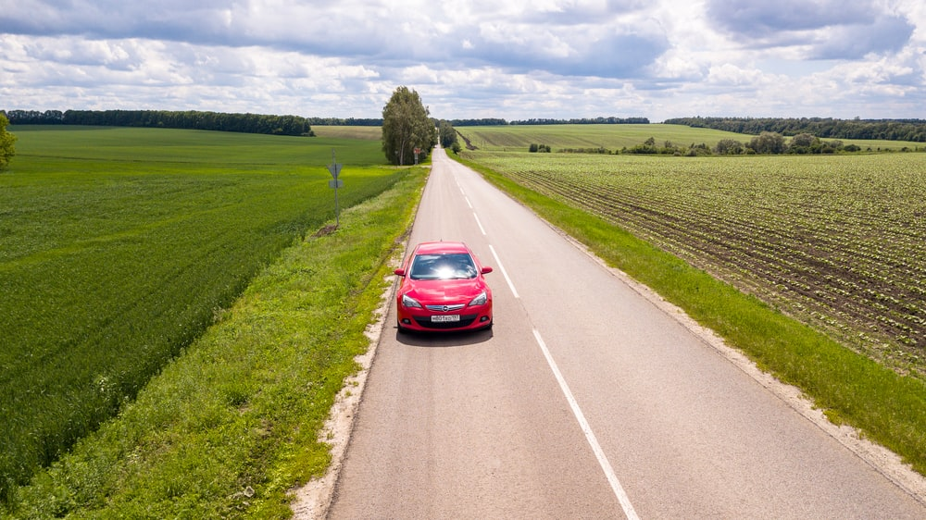
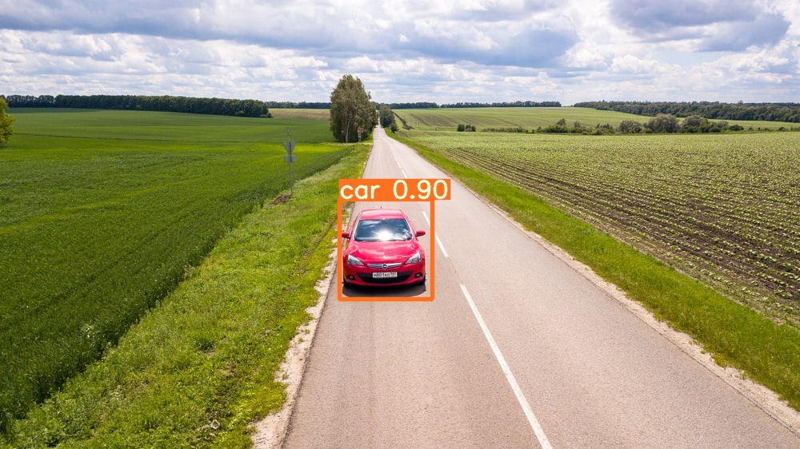
Dataset Link:- Vehicle Detection 8 Classes | Object Detection | Kaggle
Thank You
Input
Output

